Slide 1
Realizing VSF Mode
Alternatives within reach?

Slide 2
Alternative to VSF Mode: VSF2
Use +-+- instead of gg+- to avoid needing a 3 output switch:
VSF
D
A
D
A′
D
A
D
A′
VSF2
D
E
D
E
D
E
D
E
A | +-gg
D | ++gg
E | +-+-
VSF2.5
D
A
D
E
D
A
D
E

Slide 3
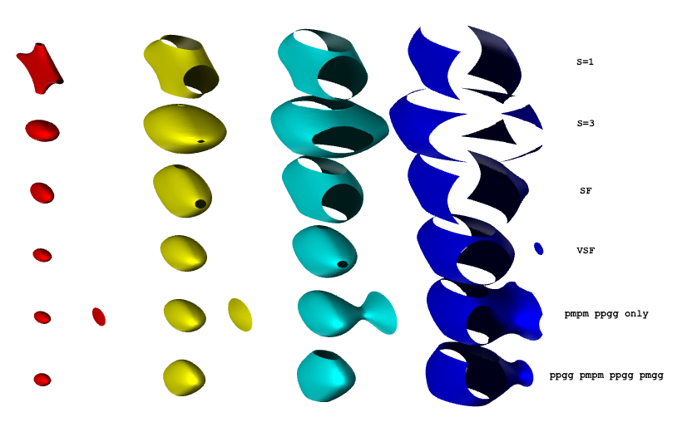
Alternative to VSF Mode: VSF2
Can look at the trap figure:
(VSF2)
(VSF2.5)

Slide 4
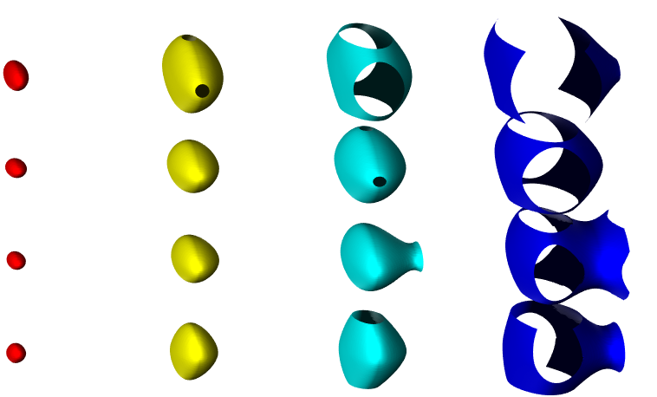
Alternative to VSF Mode: VSF2
Can look at the trap figure:
SF
VSF
VSF2
VSF2.5
$∴$SF < VSF2 ~ VSF2.5 < VSF

Slide 5
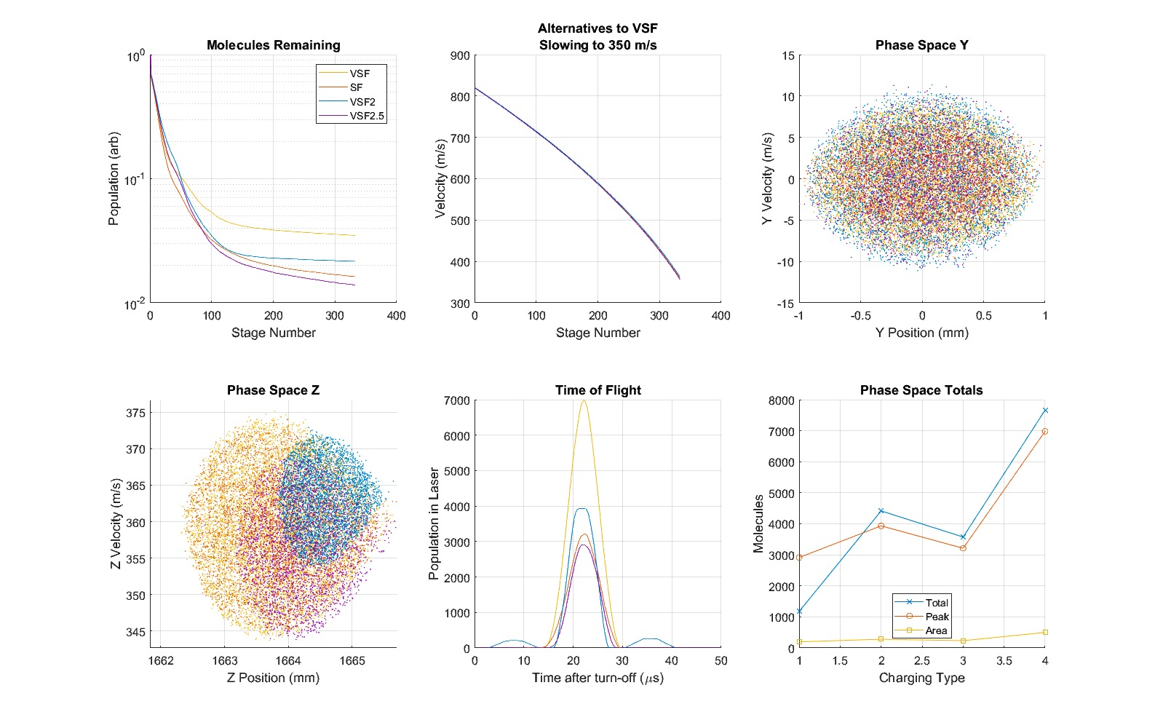
Alternative to VSF Mode: VSF2
We need simulation to see how close VSF2, VSF2.5 come to VSF:

Slide 7
Alternative to VSF Mode: VSF2
We need simulation to see how close VSF2, VSF2.5 come to VSF.
Conclusion:
VSF2.5 < SF < VSF2 < VSF
VSF2 only 25% better than SF.
Why? Maybe the asymmetry of VSF2.5 increases ergodicity, more molecules escape than in SF, VSF.

Slide 8
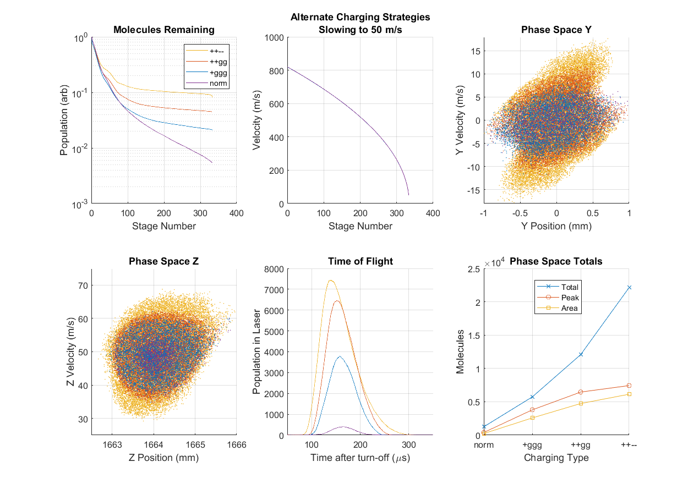
What about XSF?
Use ++-- instead of ++gg for even better focusing.
By simulation, wider phase space but not more density:

Slide 10
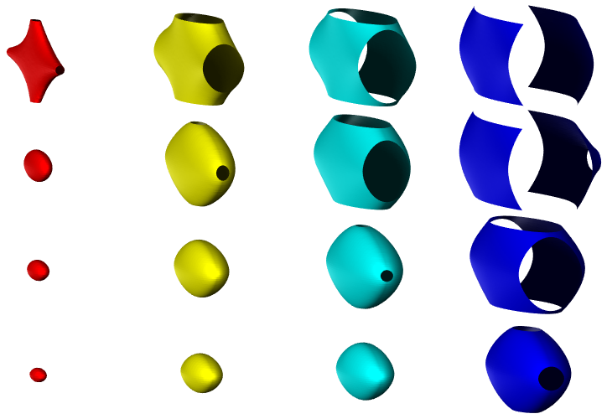
What about XSF?
But the effective moving trap looks incredible:
S=1
SF
VSF
XSF
10 50 100 200 (mK)

Slide 11
What about XSF?
Why the discrepancy?
Low final speed. The XSF effective trap has a higher frequency, and thus requires more frequent focusing events to be realized.
If we compare at higher final speed:

Slide 12
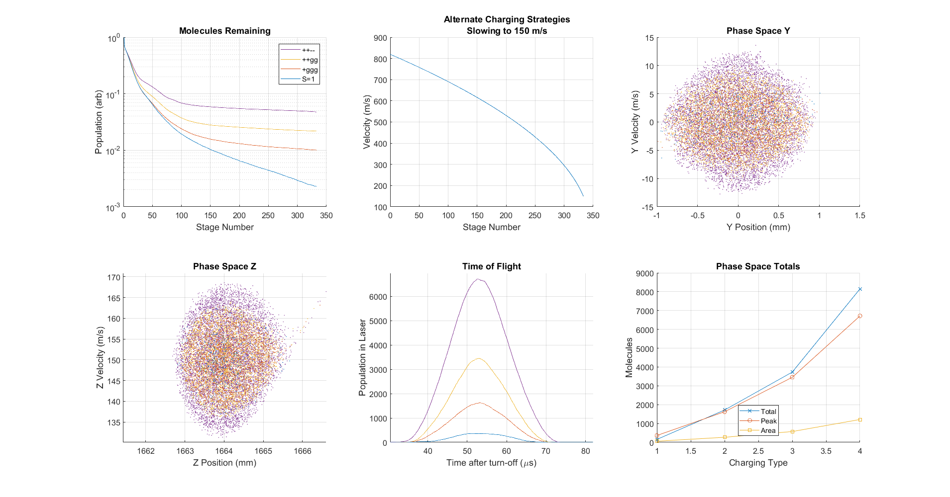

Slide 13
What about XSF?
Why the discrepancy?
Low final speed. The XSF effective trap has a higher frequency, and thus requires more frequent focusing events to be realized.
If we compare at higher final speed:
Now the transverse phase space looks more respectable.
The gain shows no sudden dip near the end.
We do need low speeds for trapping, but we should simulate trap-loading to decide, not simply ignore XSF because the phase space looks ugly.
Also, XSF2:

Slide 14
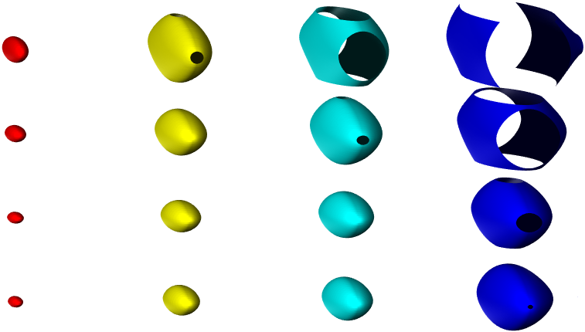
XSF2
Like VSF2, we switch between only two states, ++-- and +-+-.
Can be achieved with two 30 kV push-pull switches.
Or a 30 and a 20, running at +/-15kV and +/-10kV, which we have now
Unlike VSF2, it actually surpasses XSF slightly:
SF
VSF
VVSF
XSF2

Slide 15
XSF2
Like VSF2, we switch between only two states, ++-- and +-+-.
Can be achieved with two 30 kV push-pull switches.
Or a 30 and a 20, which we have now (!)
Unlike VSF2, it actually surpasses XSF slightly:
Why? ++-- fields are strong enough to slow on their own, +-gg not needed.

Slide 16
XSF2
Corroborate with Simulation:

Slide 17
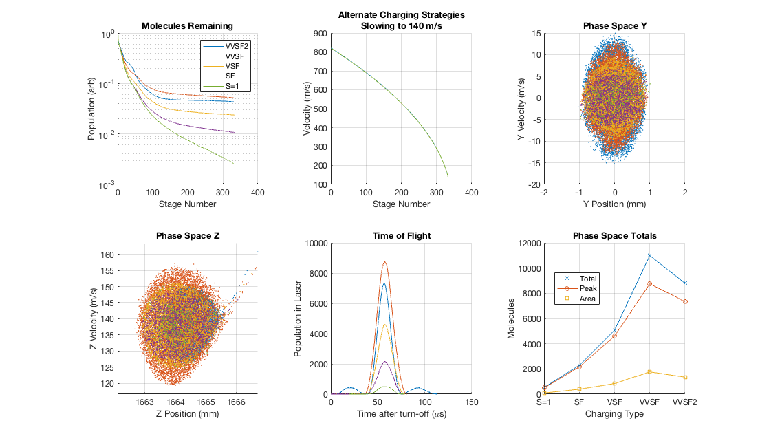
XSF XSF2

Slide 18
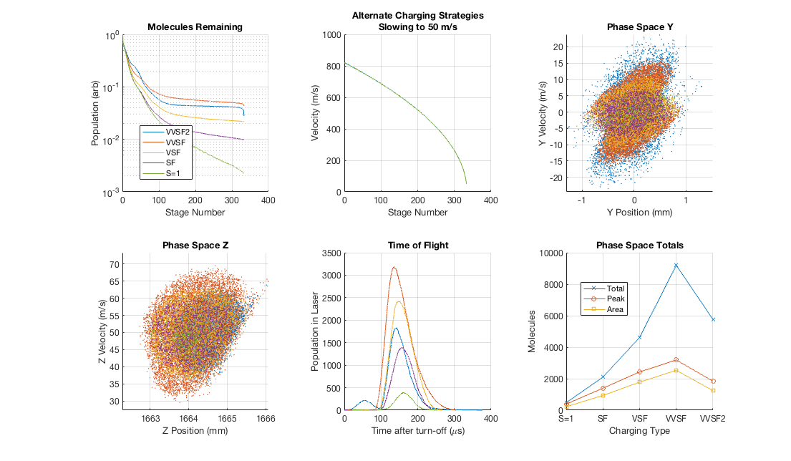
XSF XSF2

Slide 19
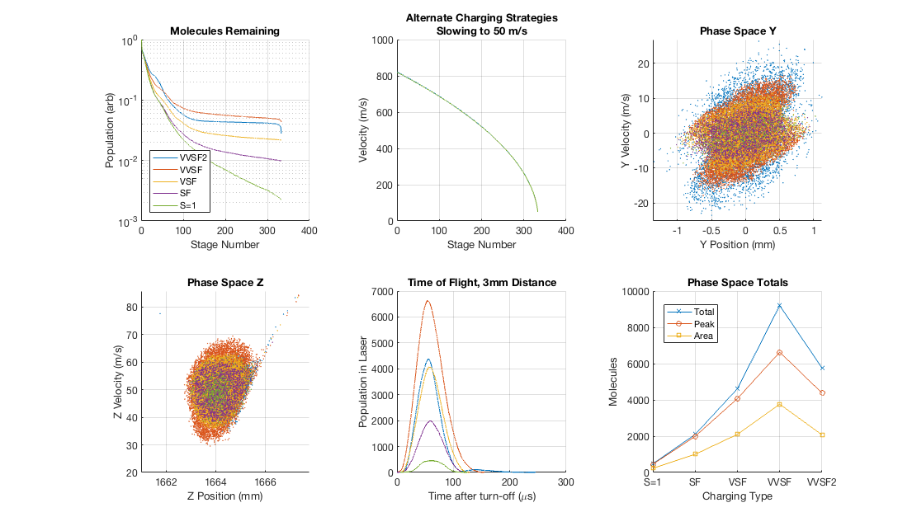
XSF XSF2

Slide 20
XSF2
Corroborate with Simulation:
Slightly worse than XSF, due to reduced Z-PSD.
Stronger negative effect at the lowest speeds for XSF2 than XSF.
Behaves worse than VSF with 8mm free flight to laser.
Not necessarily worse for trap loading.
A hybrid setup for the last few stages?
Could avoid defocusing +-+- configuration.
Maybe ++-- is overfocusing at the lowest speeds.

Slide 21
Alternative to VSF Mode: VSF2
BUT!
Running XSF/XSF2 puts full voltage across adjacent pin pairs.
Maybe we can condition for this configuration…
Configuration +-+-
-
+
-
+
+
-
+
-

Slide 22
Conditioning for XSF2 (+-+-/++--)
Surface Quality:
Best side of pins are pointing towards each other.
Worst parts are pointed away.
Sides of pins are somewhere in between.
Spacing:
Some inaccuracies in pin-pair spacing. Some may be as close as 1.5 mm to one another.
Overlap:
Much smaller than normal configuration, by more than an order.
We could just try it.

Slide 23
Electronic Requirements
To understand charge transfer we need a capacitance matrix:
Experiment (LCR SR720 Probe): COMSOL Simulation:
(pF) | Rod 1 | Rod 2 | Rod 3 | Rod 4 | GND
Rod 1 | 206 | -56 | -64.5 | -62 | -33
Rod 2 | -56 | 208 | -65 | -63 | -37
Rod 3 | 64.5 | -65 | 210 | -57 | -33.5
Rod 4 | -62 | -63 | -57 | 206 | -33.5
GND | -33 | -37 | -33.5 | -33.5 | 140
(pF) | Rod 1 | Rod 2 | Rod 3 | Rod 4 | GND
Rod 1 | 199 | -43 | -55 | -55 | -46
Rod 2 | -43 | 199 | -55 | -55 | -46
Rod 3 | -55 | -55 | 199 | -43 | -46
Rod 4 | -55 | -55 | -43 | 199 | -46
GND | -46 | -46 | -46 | -46 | 184

Slide 24
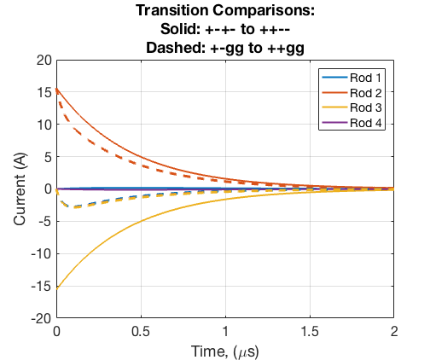
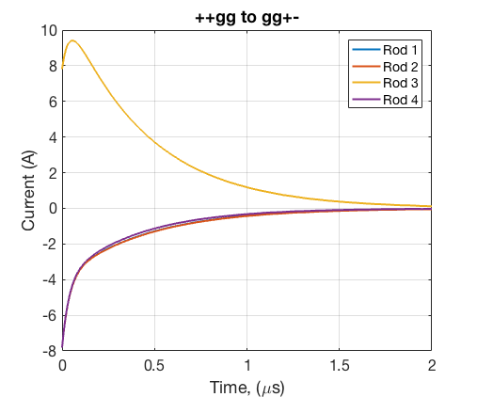
Electronic Requirements
Using Capacitance Matrix, we can solve current during edges:

Slide 25
Electronic Requirements
Next we can check power dissipated in the switches.
Assume R_on = 100 Ohms for now.
We can check the instantaneous power
Energy per switch
Continuous power at 10 Hz

Slide 26
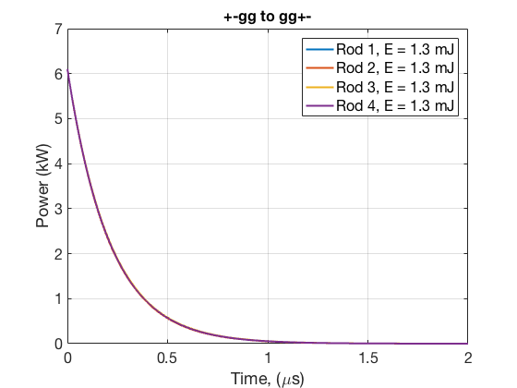
Electronic Requirements

Slide 27
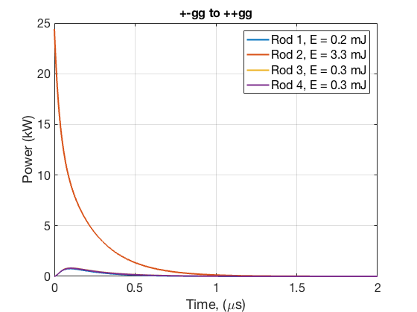
Electronic Requirements

Slide 28
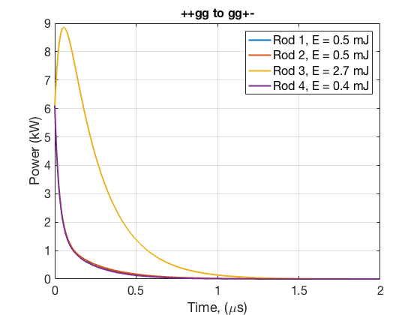
Electronic Requirements

Slide 29
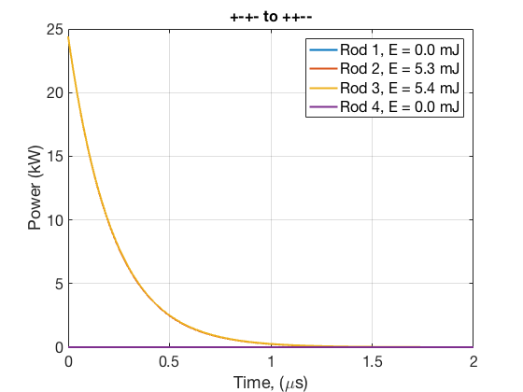
Electronic Requirements

